Slide 1

TAX POLICY CHANGES
(2018/19)
A PRESENTANTION TO
THE CHINESE ENTERPRISE CHAMBER OF COMMERCE IN UGANDA
Robinah Nakakawa
Assistant Commissioner , Service Management

Slide 2
What do we Do?
Established the 1991 Act of Parliament
To Assess, Collect and Account taxes
Advise government on tax policy.
Administer and enforce tax laws

Slide 3
Taxes Administered by URA
DOMESTIC TAXES:
Corporation Tax
Individual income tax (Forms: Presumptive, Business, Rental, PAYE, WHT)
Value Added Tax – VAT
Gaming and Pool Tax
Local Excise Duty
CUSTOMS:
Import Duty
Excise Duty
VAT on Imports
Exports duty on hides, fish
Environmental Levy
WHT
Infrastructural Levy
Domestic VAT
NON-TAX
Stamp duty
Licence fees
etc.
OTHER NON-TAX
For MDAs

Slide 4
URA Compliance Requirements
Timely registration for taxes
Prepare and keep proper records
Keep up-to-date with any new tax provisions
Make correct, timely declarations and tax payments
Seek guidance from URA through any of the channels

Slide 5
Support provided to ease Compliance
Tax education…It is a right of a tax payer to know about taxes
Stakeholder Engagements (…continuous engagement)
Cost effective tax compliance environment…
1 Online registration and filing
2 Various payment platforms
3 Increased visibility (38 DT office locations, BMS in Kampala Metro)
4. Call center services and social media platforms
5. Advance Ruling for transactions where tax implication is unknown
6. Tax Dispute Mechanism

Slide 6
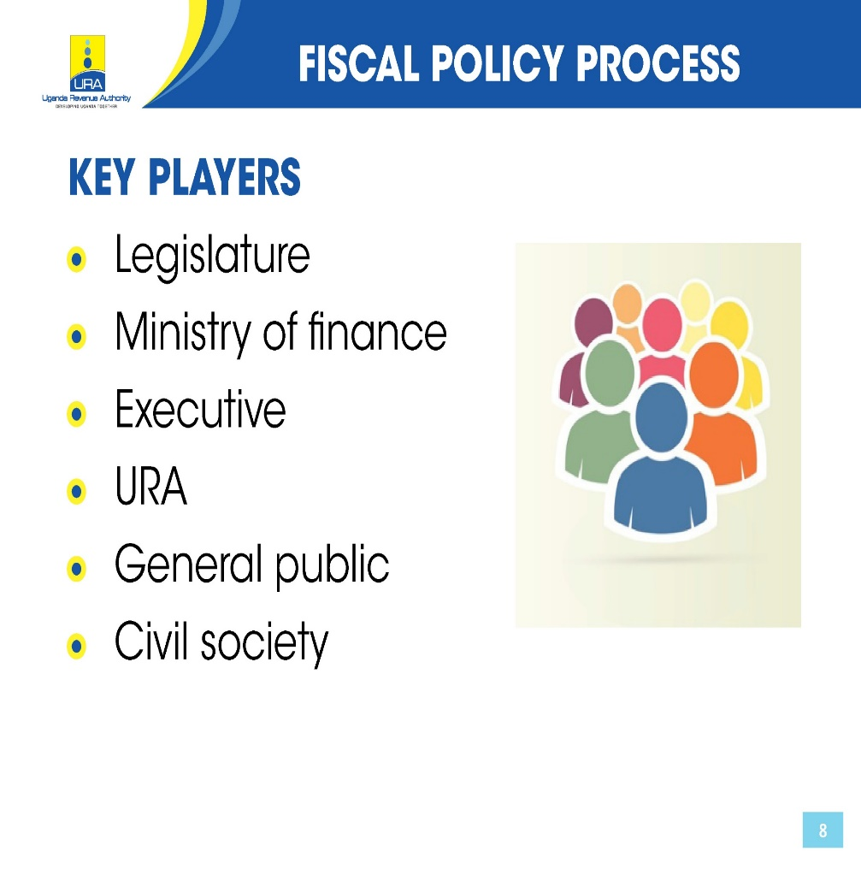
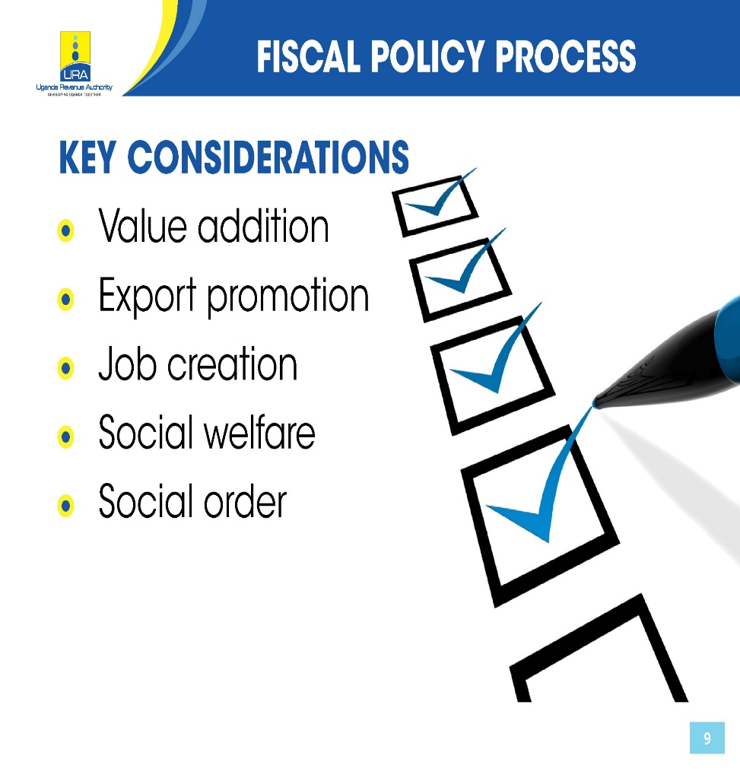
Fiscal Policy Process
Notes:
Other key considerations include
Enhanced tax payer compliance
Fiscal equity
Widening tax base
Improving tax administration

Slide 7
TAX POLICY CHANGES FY 2018-19
INCOME TAX
Policy | Justification
Introduce 10% Withholding Tax on Commissions by Telecom Companies | Enhance Tax Compliance among commission agents who have not been paying tax
Clarify on Taxation of offshore indirect transfers of interest by imposing tax on a direct or indirect sale of an asset connected to Uganda by a none-resident person | Minimize Tax avoidance arising from indirect sale assets connected to Uganda
Apply withholding Tax on all Winnings of Gaming, Sports and Pool Betting Payments | Clarify the scope to include all gaming activities(online, virtual, etc)

Slide 8
TAX POLICY CHANGES FY 2018-19
INCOME TAX
Policy | Justification
Align the treatment of returnable containers by manufacturers with accounting treatment | Widen the Tax base
Strengthen the effectiveness of the current limitation of excessive interest deduction (thin capitalization) | Widen the Tax base

Slide 9
TAX POLICY CHANGES FY 2018-19
VALUE ADDED TAX (VAT)
Policy | Justification
Clarify the Obligation of foreign based remote service providers to account for VAT in Uganda | Widen the tax base and enforce compliance for online services consumed in Uganda
Exclude goods for private use from the scope of the application of the VAT deemed payment provisions | Widen the Tax base
Oblige Government Ministries , Departments and Agencies and designated persons to with VAT on their purchases | Enhance compliance where suppliers have not been consistent in filing and paying VAT
Streamline carry forward of VAT offsets | Enhance compliance and minimize abuse of offsets

Slide 10
TAX POLICY CHANGES FY 2018-19
EXCISE DUTY
Policy | Justification
Introduce specific equivalent tax rates on spirits and wines | Rationalize excise on alcohol-specific equivalents were introduced on beer in FY 2017-18
Introduce Excise duty on opaque beer (kibuku) Shs 650 per litre | Widen the Tax base
Impose excise duty of Shs 200 per litre on cooking oil | Widen the Tax base
Levy 1% on the value of mobile money transactions | Widen the Tax base
Impose Excise duty at 15% on all juices including powders for reconstruction like tang and dilute to taste drinks | Widen the Tax base

Slide 11
TAX POLICY CHANGES FY 2018-19
EXCISE DUTY
Policy | Justification
Harmonize excise duty of 12% on all telecommunications services (phone talk time on mobile phones , landlines, value added services) | Rationalize excise related telecommunications services
Increase excise duty on diesel and petrol by Shs. 100 per litre | Raise funds for road maintenance
Increase excise duty on mobile money and bank charges from 10% to 15% | Enhance revenue
Impose excise duty of Shs. 200,000 on motorcycles at first registration | Enhance Revenue
Daily levy of Shs. 200 on Over The Top services | Widen the Taxbase
Reduce Excise duty on Soft Drinks from 13% to 12% | Improve return on investment in this sector

Slide 12
TAX POLICY CHANGES FY 2018-19
NON TAX REVENUES(NTR)
Policy | Justification
Increase motor vehicle first registration fees from Shs. 1,200,000 to Shs. 1,300,000 | Enhance Revenue
Expand the scope of environmental levy to include goods vehicles over 7tonnes | Enhance Revenue
Ban on imports of motorvehicles of 15 years and over from the year of manufacture | Reduce pollution, save foreign exchange and provide a conducive environment for motor vehicle assembly
Review environment levy on motor vehicles | Encourage importation of newer motorvehicles

Slide 13
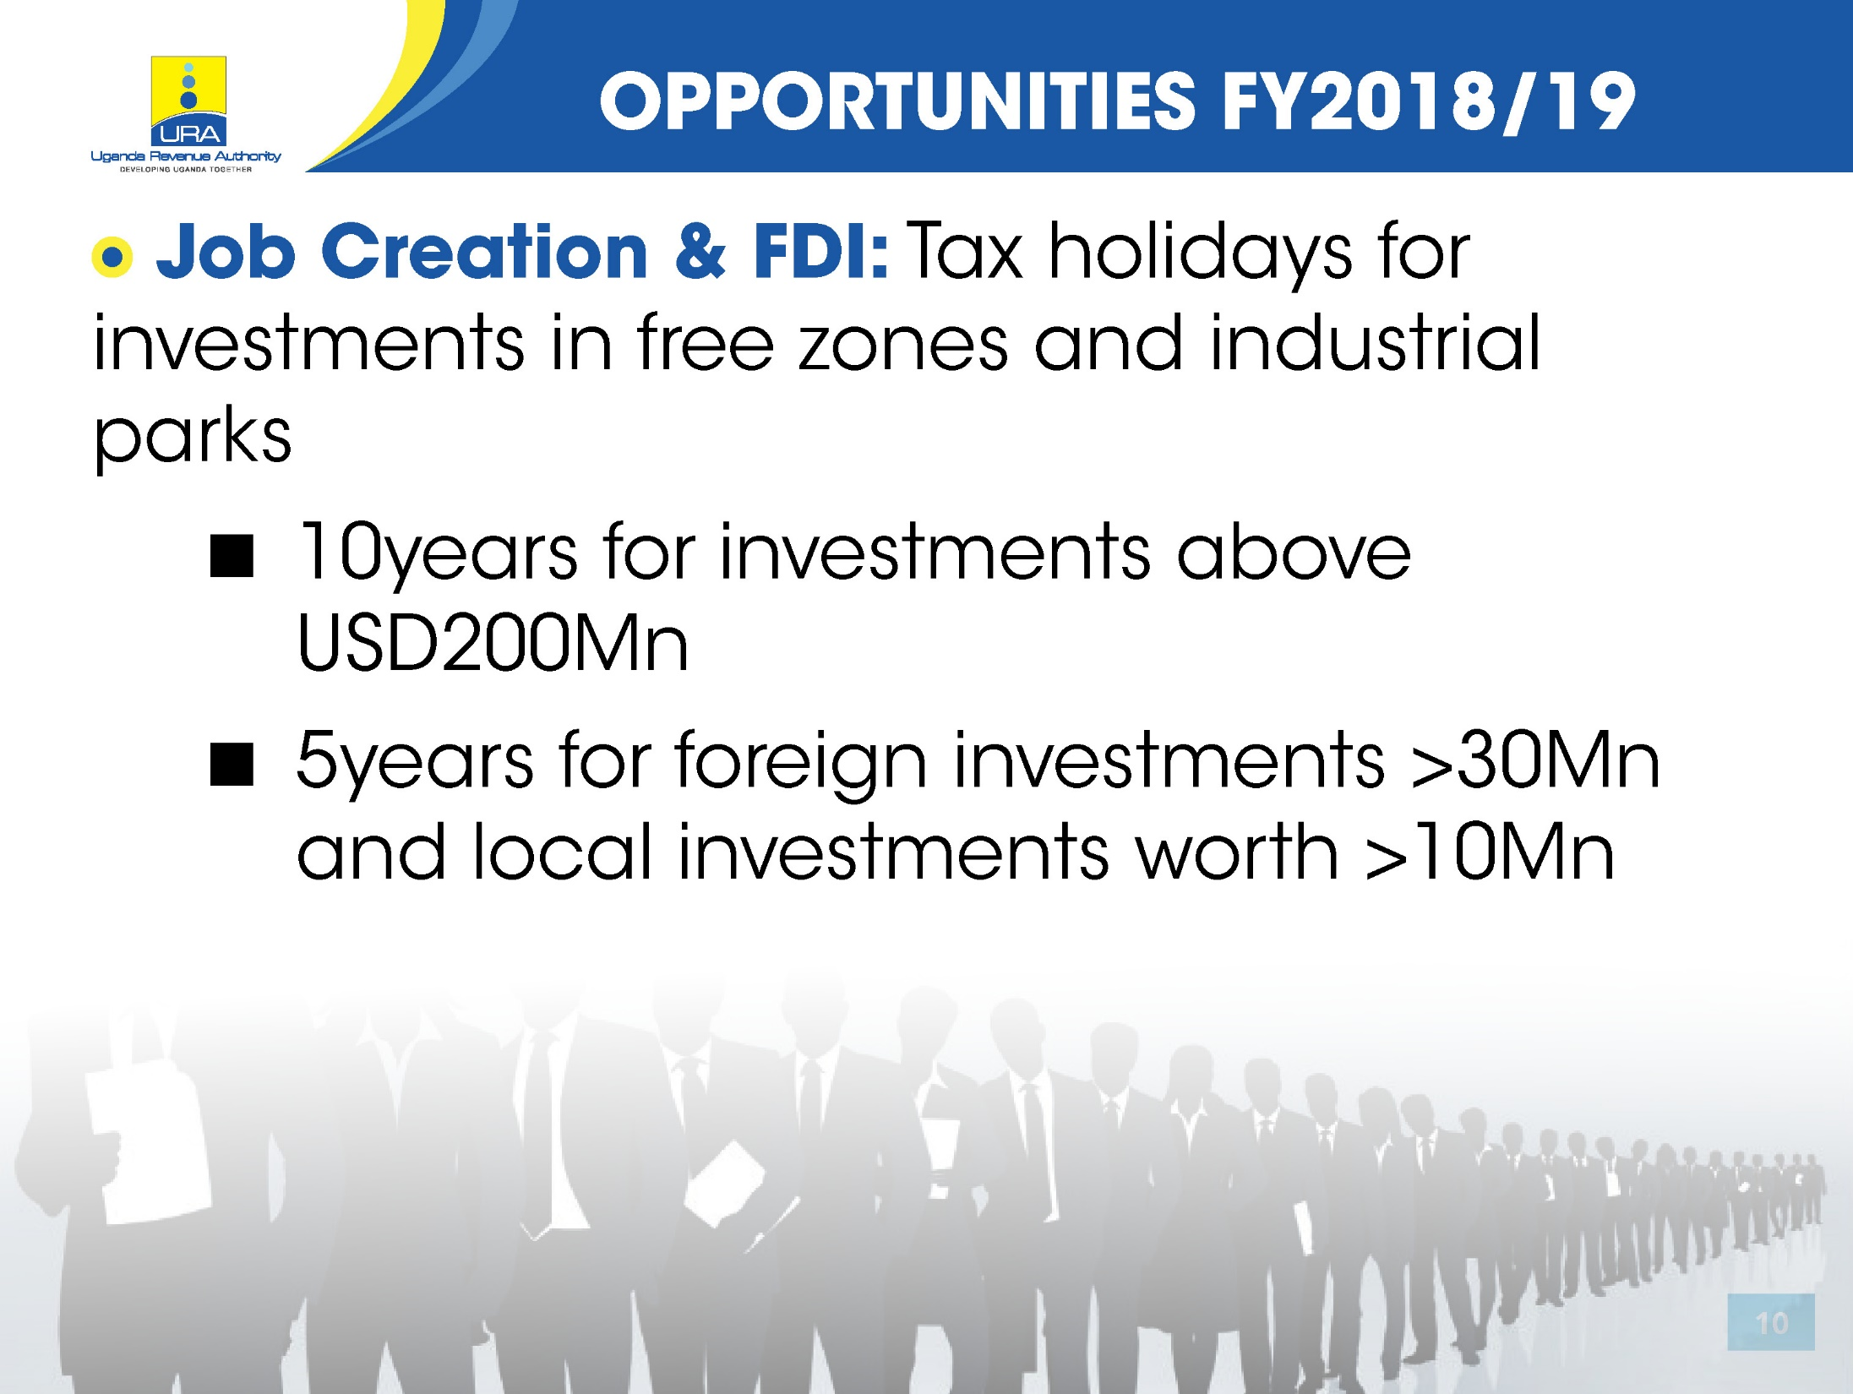

Slide 14


Slide 15
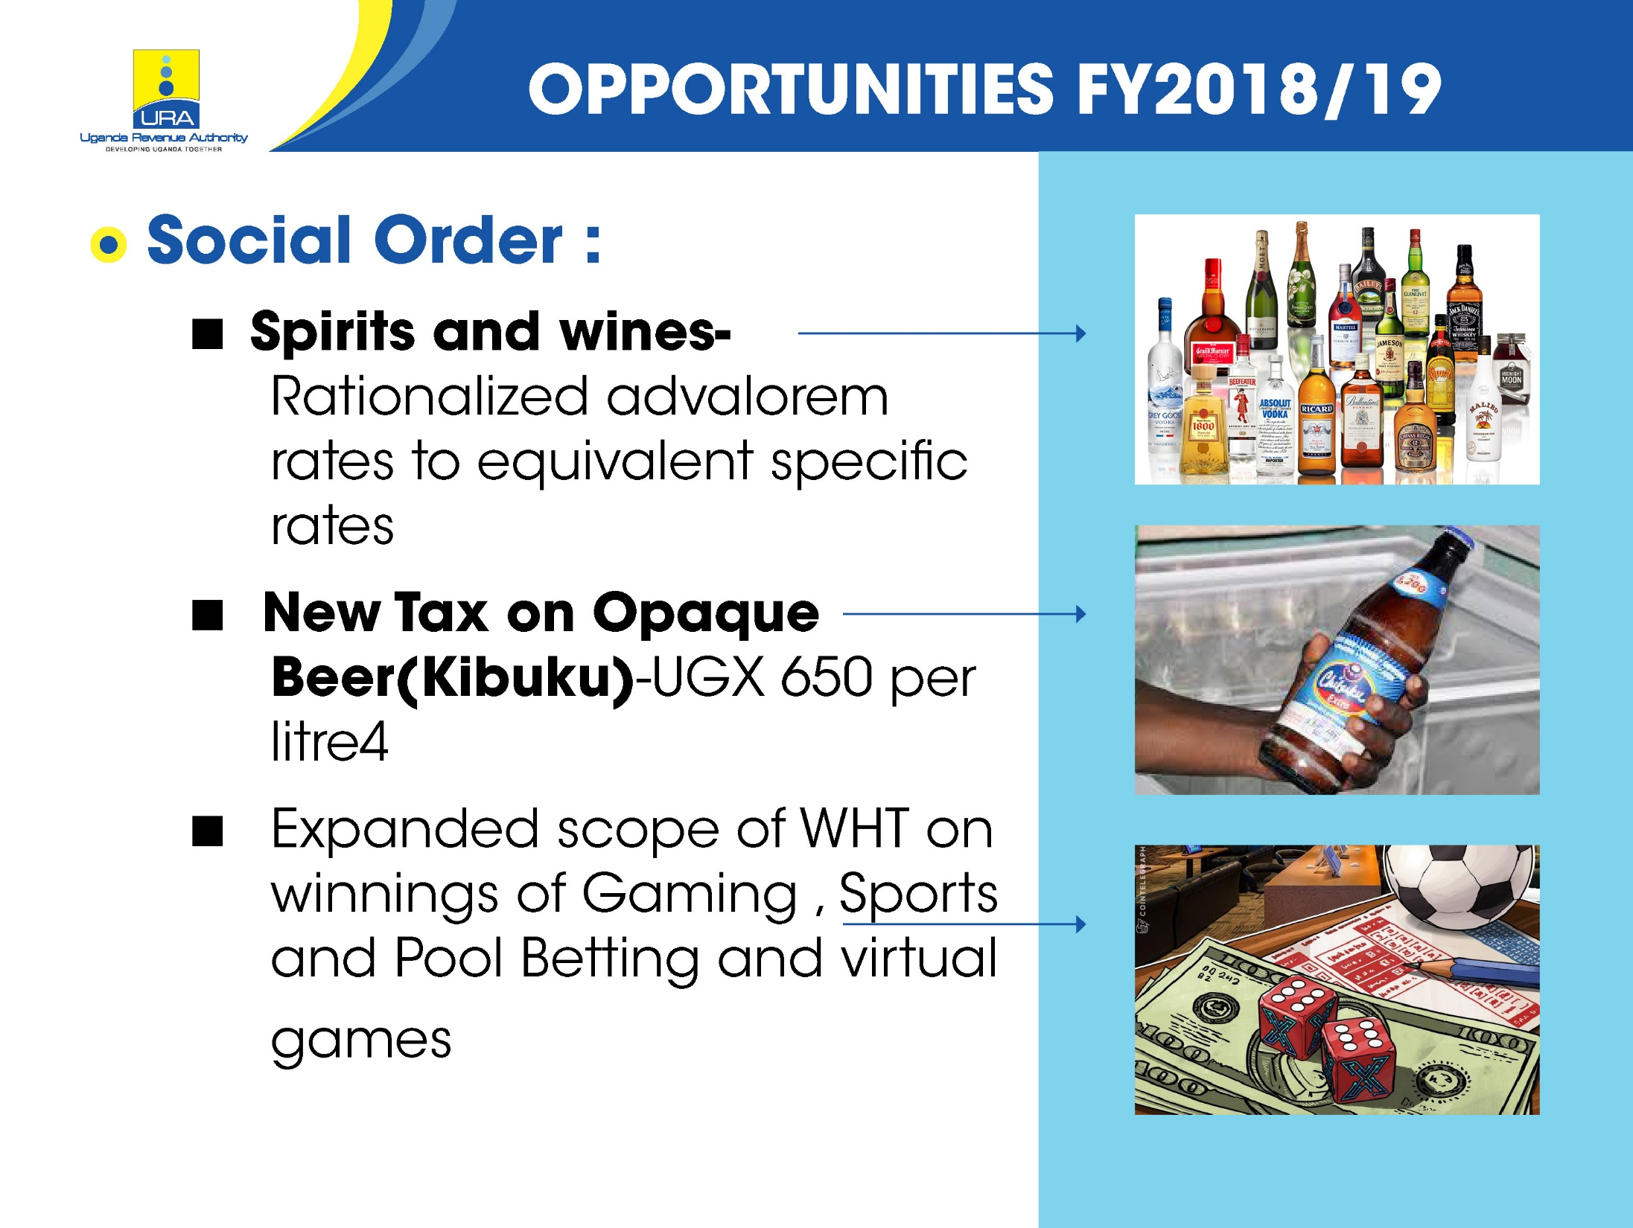

Slide 16
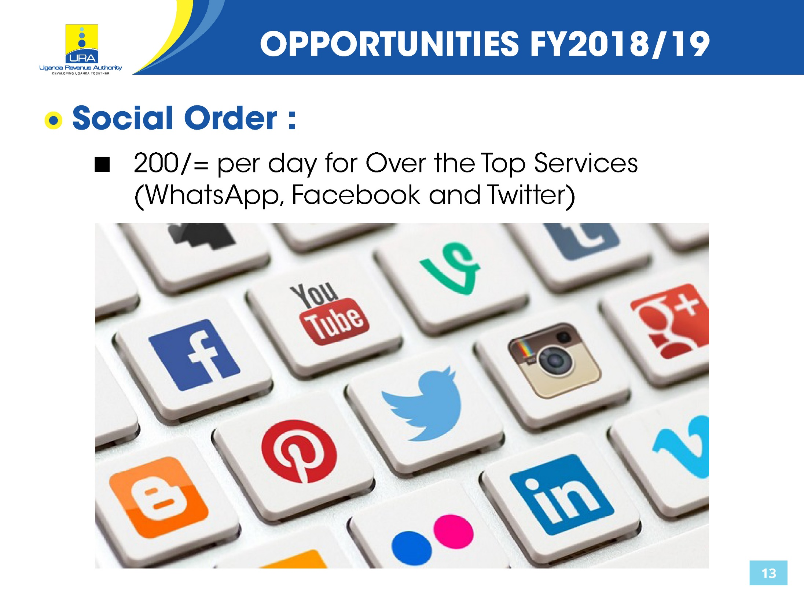

Slide 17
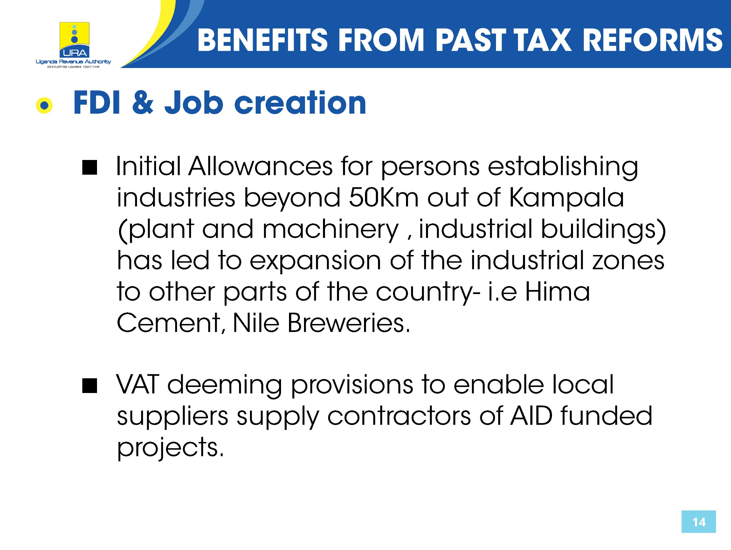

Slide 18


Slide 19
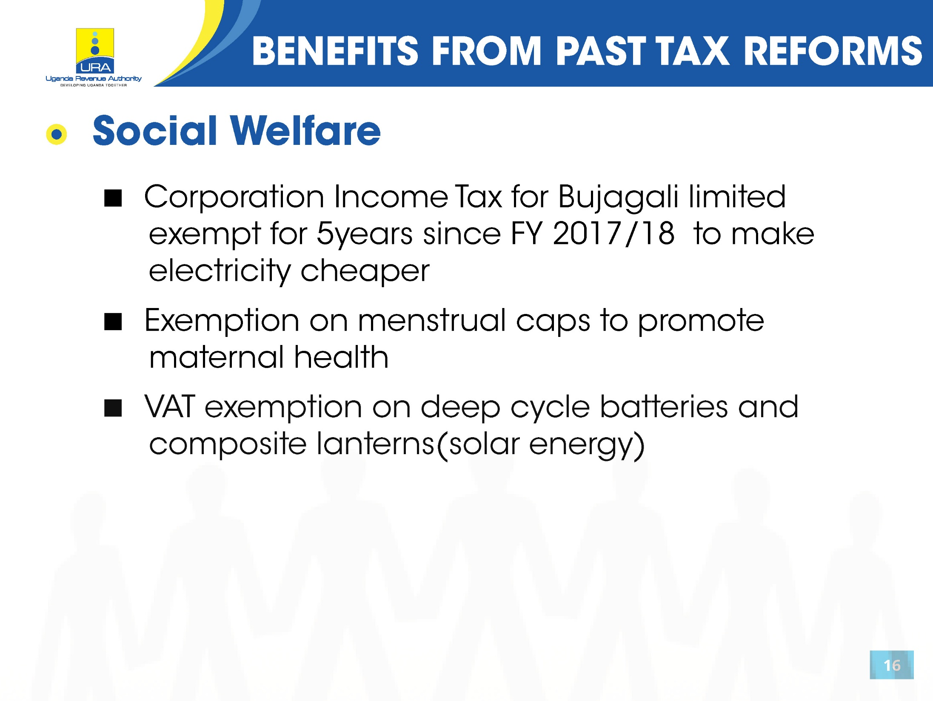

Slide 20
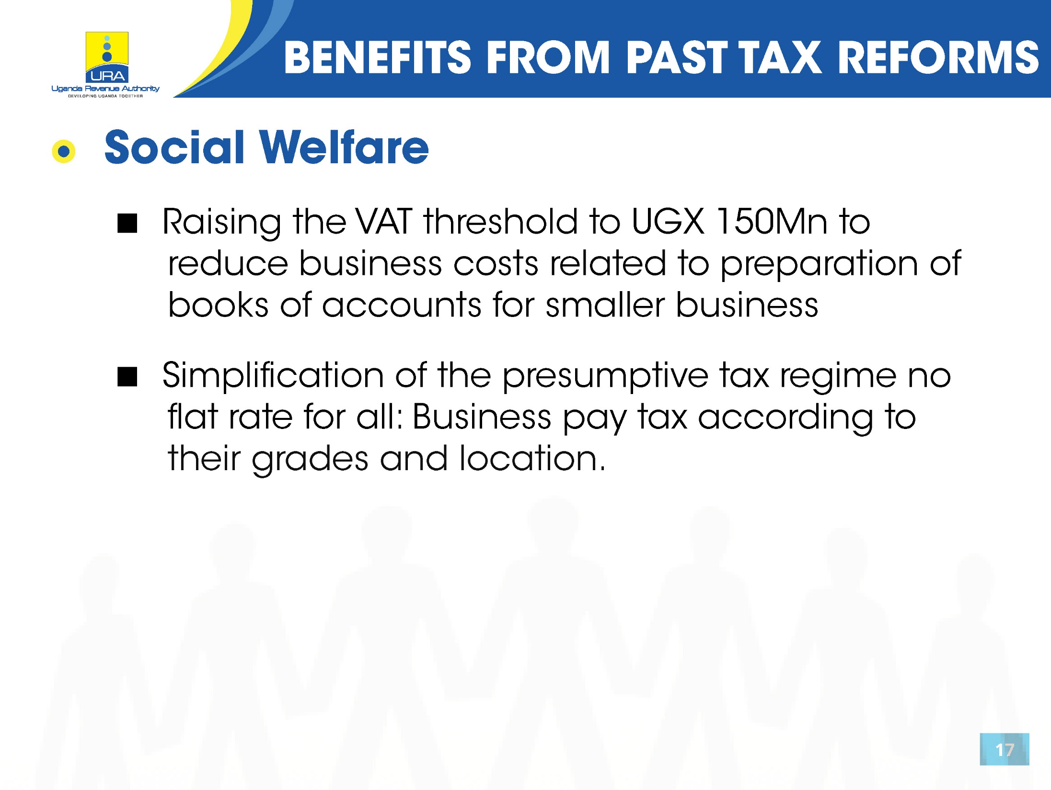

Slide 21


Slide 22


Slide 23


Slide 24
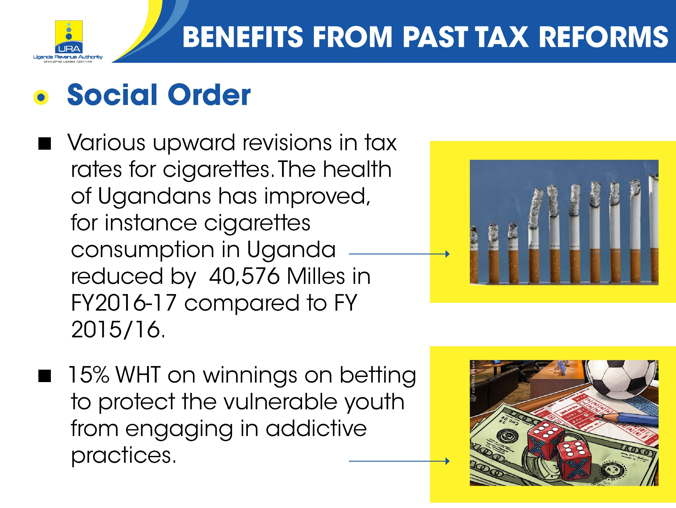

Slide 25


